Slide 1
CAPSTONE PROJECT UPDATE
Rafah Asadi, Brett Bejcek, Peter Jacobs, Kyle Voytovich
MARCH 21,2017

Slide 2
OVERVIEW
WHAT WE HAVE DONE ----------------------
BUILT DATABASE
AGGREGATION
FIRST LOOK
WHERE WE ARE -----------------------------
MODELING TECHNIQUES
UNDERSTANDING COMPLEXITIES
WHAT WE ARE DOING NEXT ----------------
SIGNIFICANT VARIABLES
SUGGESTIONS

Slide 3
SQLITE
FROM EXCEL TO SQLITE
UNDERSTANDING RELATIONSHIPS BETWEEN TABLES
DATABASE CREATION

Slide 4
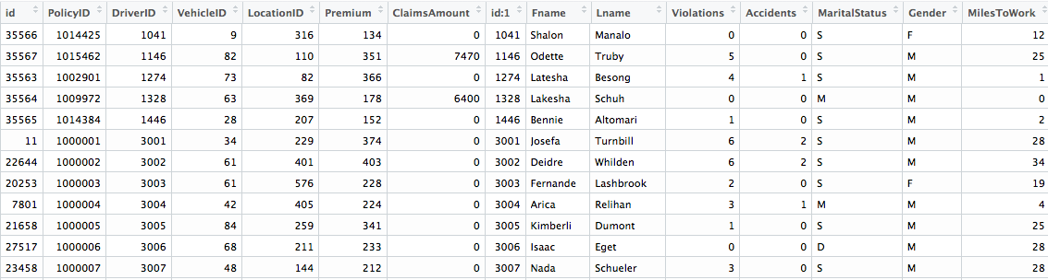
CREATING ONE TABLE
37 FEATURES
EASILY COMPUTE LOSS RATIOS
35,712 ENTRIES
EXAMINE INTERACTIONS
ALL TABLES USED
ALLOWS FOR COMPLEX ANALYSIS
DATA AGGREGATION

Slide 5
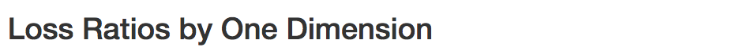
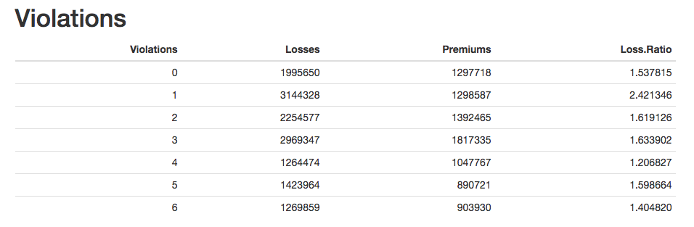
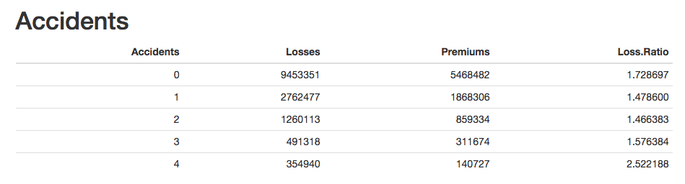
FIRST LOOK

Slide 6
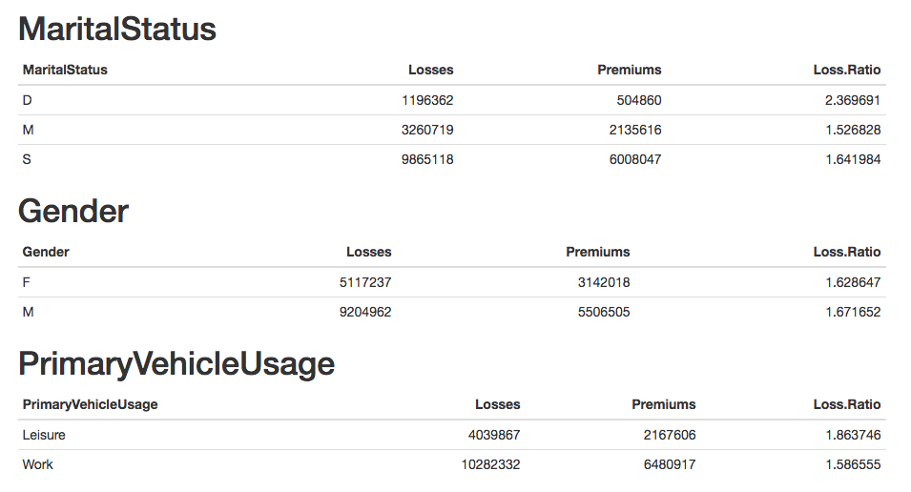
FIRST LOOK

Slide 7
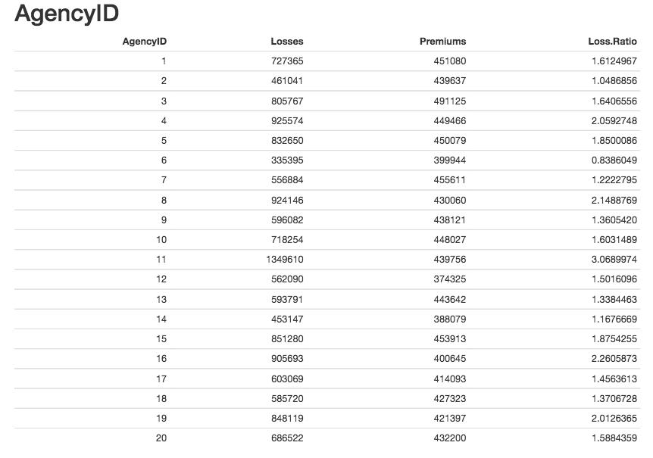
FIRST LOOK

Slide 8
TOTAL PREMIUM AMOUNT BY VEHICLE ID
FIRST LOOK

Slide 9
TOTAL NUMBER OF PREMIUMS
BY VEHICLE ID
FIRST LOOK

Slide 10
LOSS RATIO BY VEHICLE ID
FIRST LOOK

Slide 11
% OF DRIVERS WHO MADE CLAIM BASED
ON DRIVER ID
FIRST LOOK

Slide 12
PREMIUM BY (LOG) AVG VEHICLE PRICE [RED = 220, GREEN = 240, PURPLE = 260]
FIRST LOOK

Slide 13
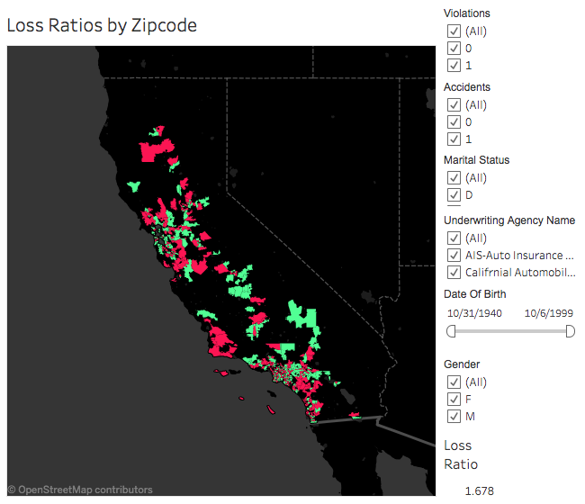
FIRST LOOK

Slide 14
MODELING TECHNIQUES -------------------
CLUSTERING
REGRESSION MODELS
TREES
SUBSETTING
INTERACTIONS
SUGGESTIONS -------------------------------
BASED OFF OF ANALYSIS
RESEARCHING IMPACT
NEXT STEPS

Slide 15
QUESTIONS?

